Slide 1
Drew Stringer
Andres Parra
Shamlan Albahar
LeAlan Kinlecheenie
Fahad Alhowaidi

Slide 2
Project Description
Transform 2015-2016 Baja Car to Full Electric
Work along EE Capstone team
Conform to E-Baja Safety Rules
Compete against 2019 Baja Car
Client is David Willy
Financially sponsored by W.L. Gore

Slide 3
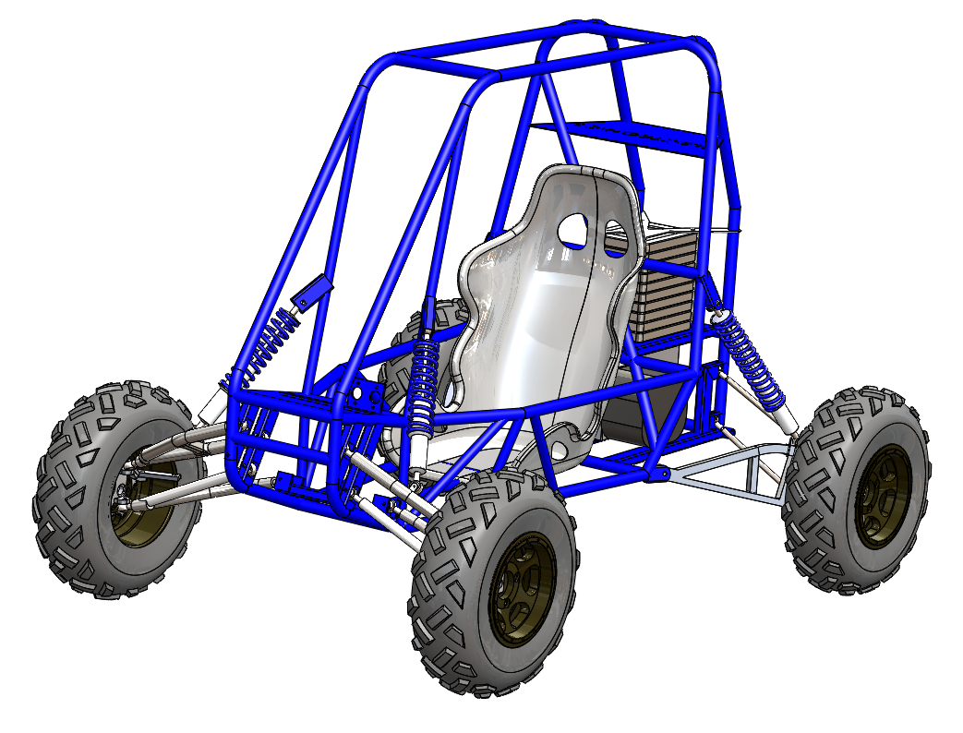
Design Description
Full car model
Front car model
Rear suspension model
Gear box model

Slide 4
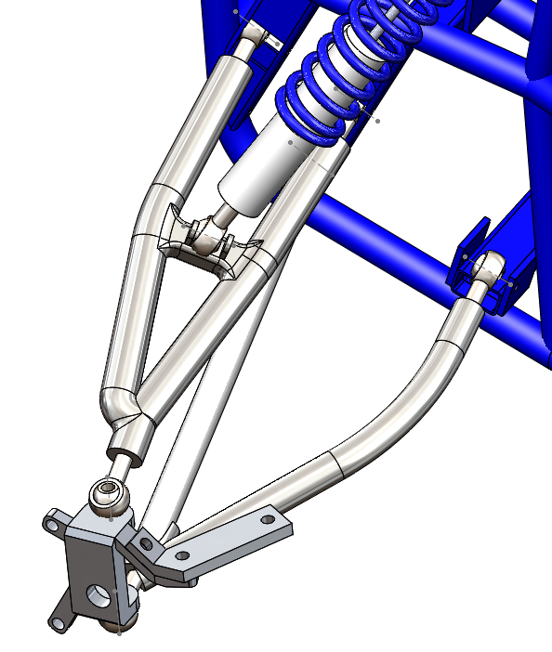
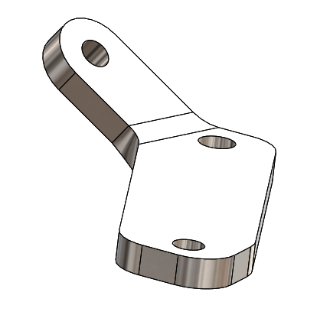
Front Car Model

Slide 5
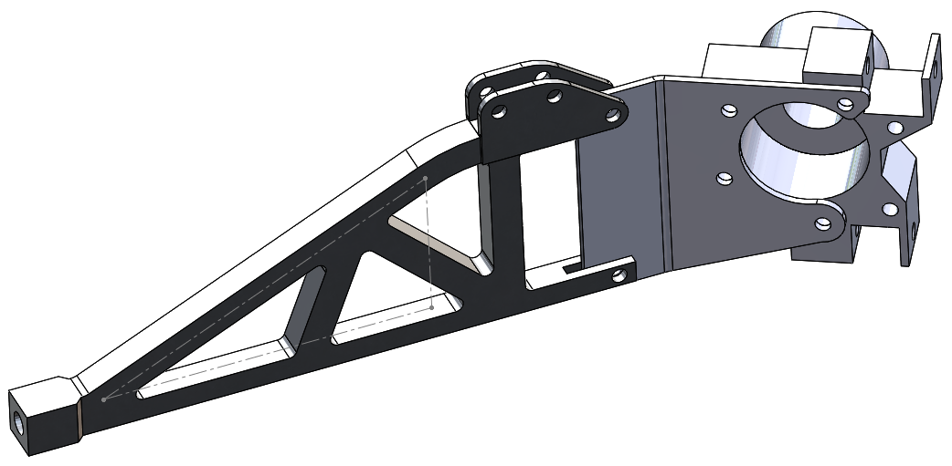
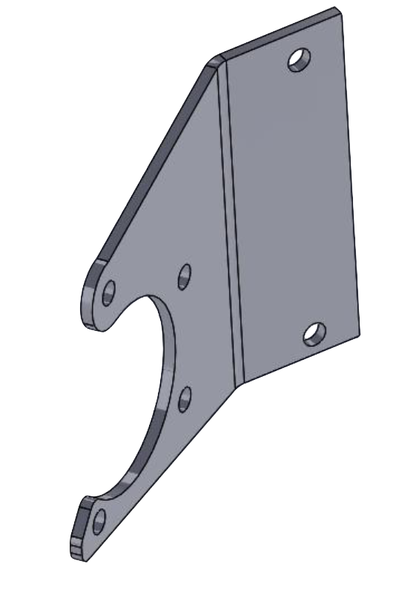
Rear Suspension Model

Slide 6
Rear Suspension Model

Slide 7
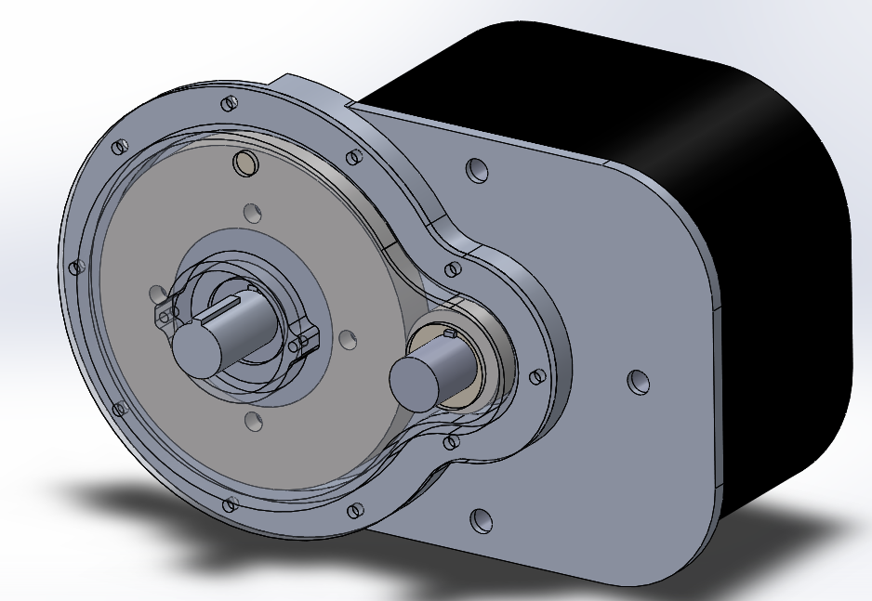
Gearbox Model

Slide 8
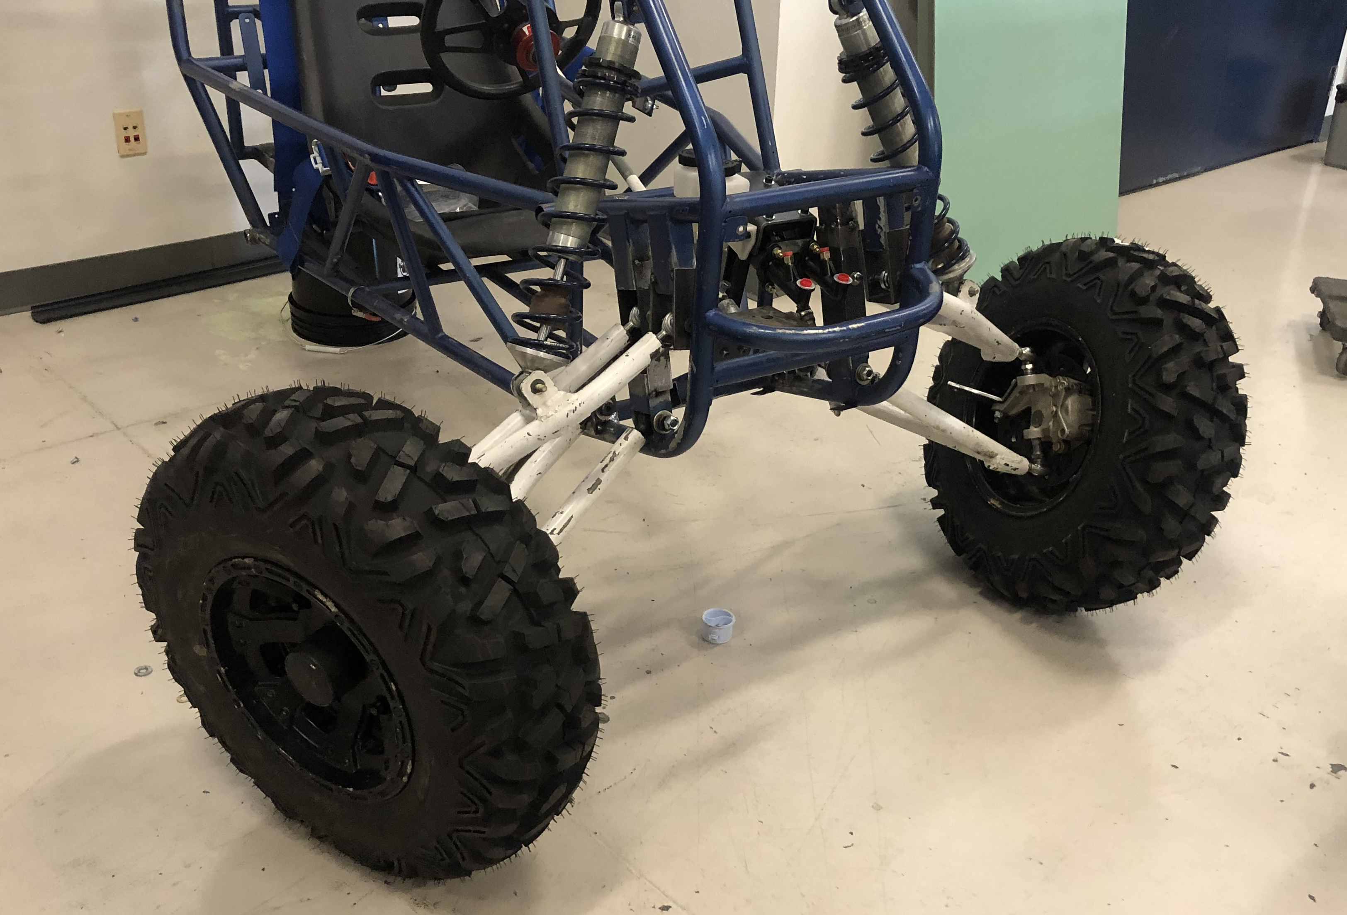
Current State

Slide 9
Engineering Requirements

Slide 10
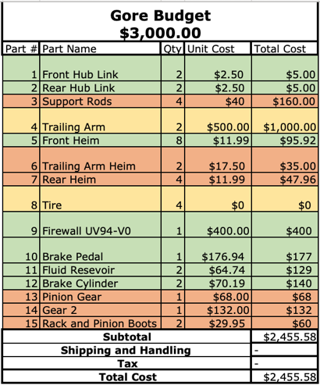
Bill of Materials

Slide 11
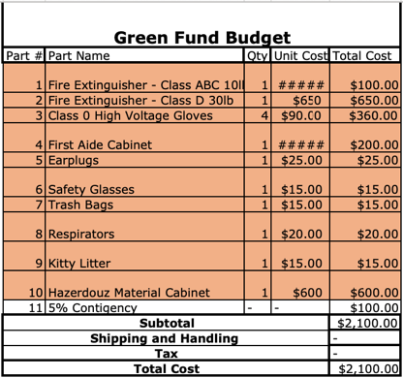
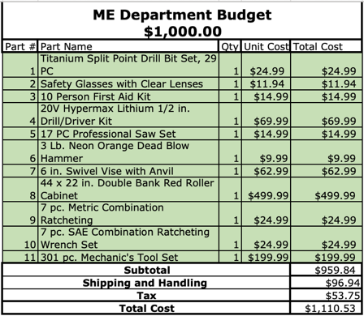

Slide 12
Gantt Chart

Slide 13
Implementation Plan
Ordered remaining parts
Front car is undergoing manufacturing
Electrical components can begin to be attached by March 13th
Brakes, steering, and front suspension due date is March 9th
Rear suspension and gear box will be attached before March 29th

Slide 14
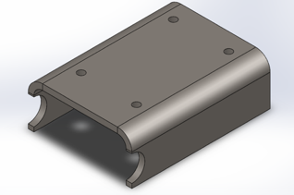
Brakes ( Drew )
Create a stable mount for cylinders and pedal
Brake pedal attached
Brake cylinders are attached
Hoses attached from reservoirs to cylinders
Need to attach to brake calipers

Slide 15
Gearbox (Drew)
Finalize CAD model
Submit work order
Utilize old gears
Mount motor after spring break
Attach gear and sprocket once gearbox is mounted

Slide 16
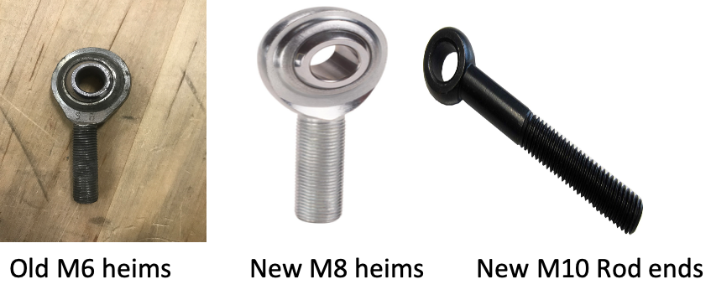
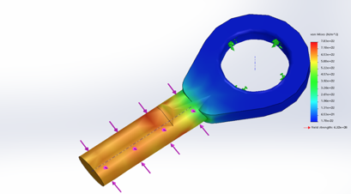
Front suspension (Fahad)
FEA on new heims
Client approval for the new heims and rod ends
Remanufacture the old front suspension
Drill bigger holes on the arms and then tapped it to fit the new heims and rod ends
Grinding to make the suspension flat before welding
Welding to make space for the new rod ends

Slide 17
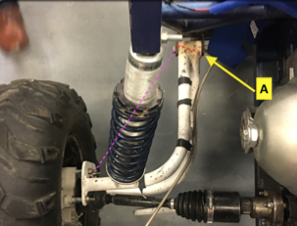
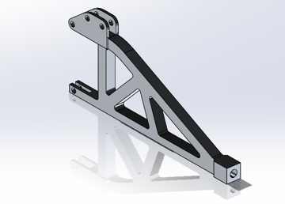
Rear suspension (Andres and Shamlan)
Designed a new trailing arm
Suspension geometry agrees
Passed by Mr. Willy
MarZee Water Jet Services
Product completion by March 20th
Support rods to be purchased soon

Slide 18
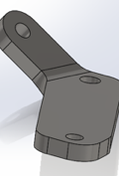
Steering (LeAlan)
Cut shape with a cut-off wheel
Clean edges with grinder wheel
Create bend with hydraulic press
Create holes with mill for precision

Slide 19
Testing Plan
Rear Suspension needs to perform on impact terrain.
Brakes will be tested at certain speeds and checked for tire rotation (all four wheels should lock)
Steering links will be checked for degrees of rotation
Gearbox will be tested at increasing speeds with the motor attached
Front suspension will be tested by applying load on it

Slide 20
Questions?

